Slide 1
“Smart Street Lighting System for Energy Efficiency, based on Microcontroller”
Presented By:
Alinoor Hossain Olip
Abdur Rahman
Hasan Shakif Tushar

Slide 2
Overview
Introduction
Hardware and Software
Working Procedure by Steps
Limitations
Conclusion

Slide 3
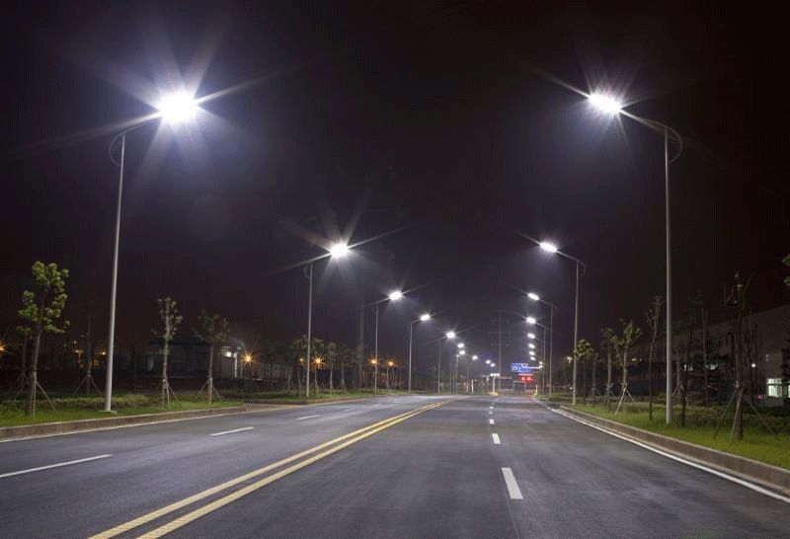

Slide 4
Introduction
Almost everything is being converted to IoT
Why not our street lights?
10-38% electricity bill consumed by street lights
Traditional street light is not efficient
Can be more efficient by IoT and smart control
We tried to build a project for energy efficient street lighting system

Slide 5
Hardware and Software
Arduino Uno
LDR Sensor
IR Sensor
Resistor 10k
LEDs
Connecting Wire
Breadboard
Laptop
Arduino IDE

Slide 6
Working Procedure by Steps
Start
Connect Arduino to PC via USB
Run codes in Arduino IDE
If LDR <= 200, Fade the LEDs
If IR < 200, Increase brightness of LEDs
If IR >= 200, Fade the LEDs again
If LDR > 200, Turn off the LEDs

Slide 7
Limitations
Not for commercial use
Limited number of sensors and LEDs
One LED for one IR sensor
IR sensor range is very low
LEDs are not bright enough (8 bit LED)

Slide 8
Conclusion
We hope this project will help to reduce the waste of electricity. In near future, this system should be implemented in every road.
We will work on it later to make it more efficient and we’ll add new features too.

